Slide 1
Data Structures ICT-1211 Information and Communication Technology
Lecture-30
Date: //2024

Slide 2
Graph

Slide 3
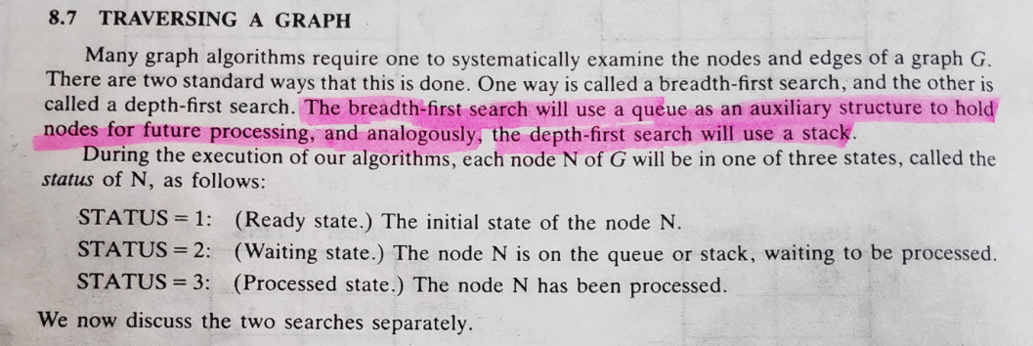
Graphs

Slide 4
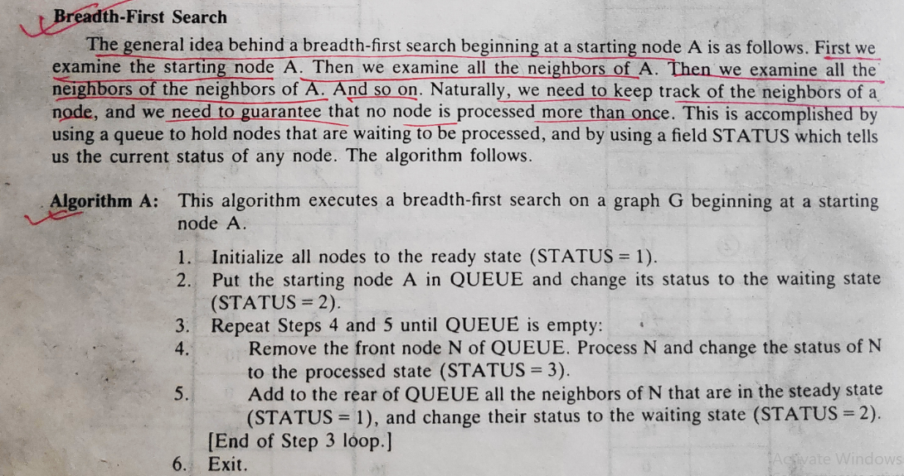
Graphs

Slide 5
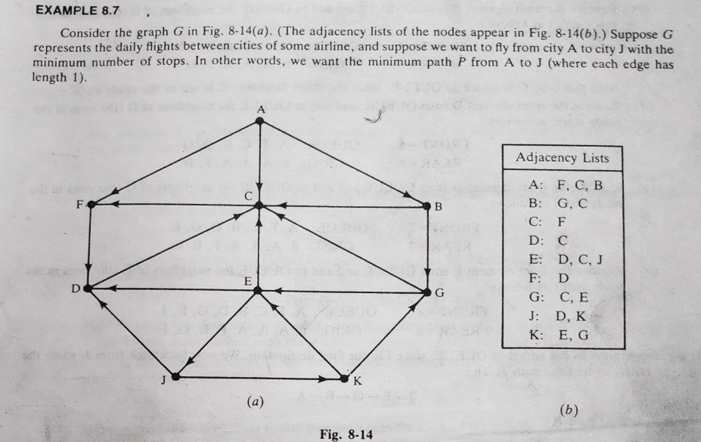
Graphs

Slide 6
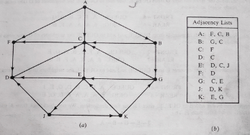
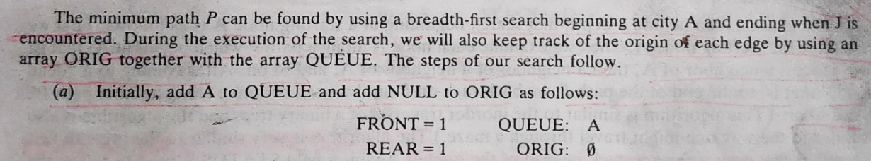
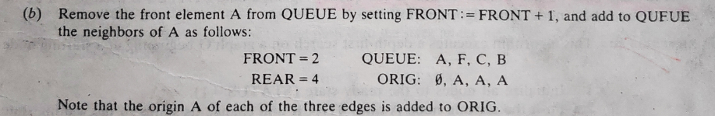
Graphs

Slide 7
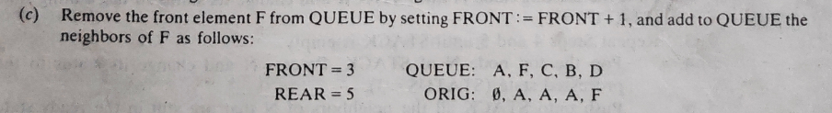
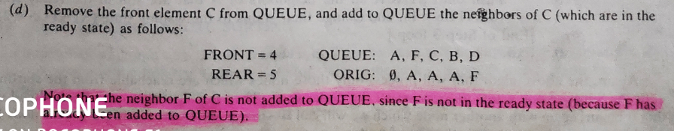
Graphs

Slide 8
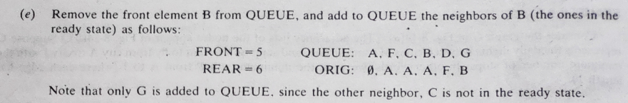
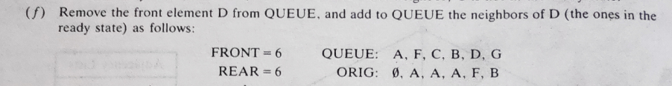
Graphs

Slide 9
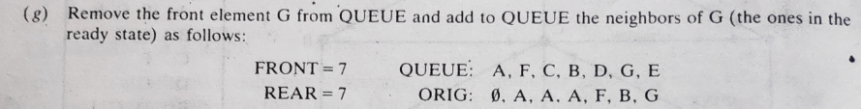
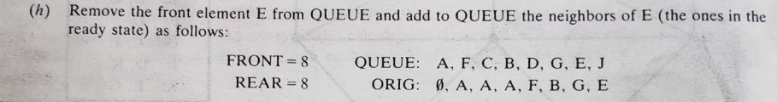
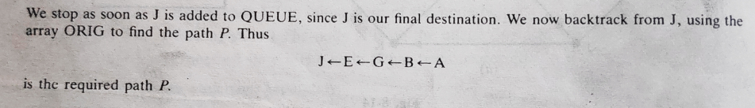
Graphs

Slide 10
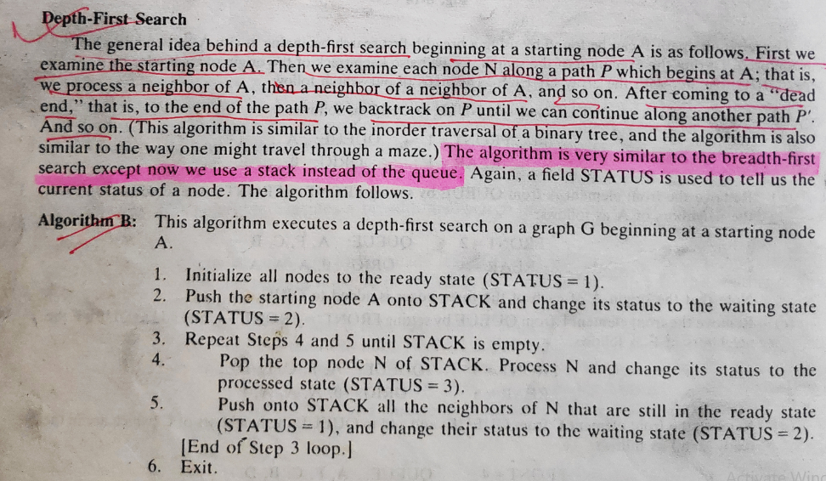
Graphs

Slide 11
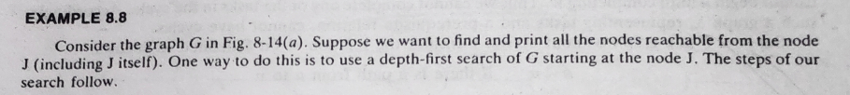

Graphs

Slide 12
Graphs

Slide 13
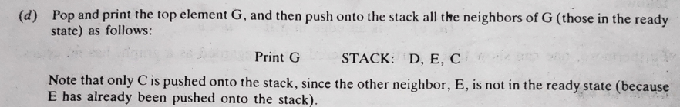
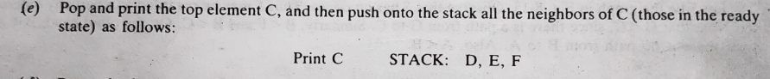
Graphs

Slide 14
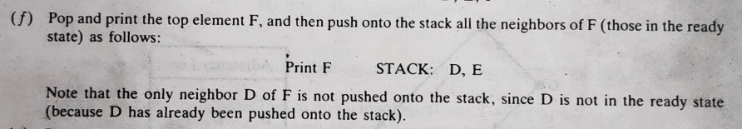
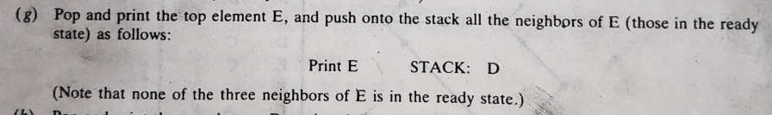
Graphs

Slide 15
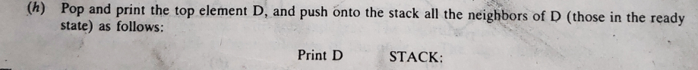
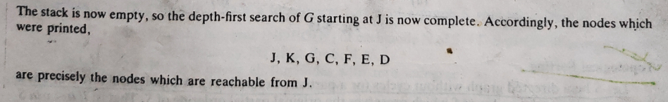
Graphs

Slide 16
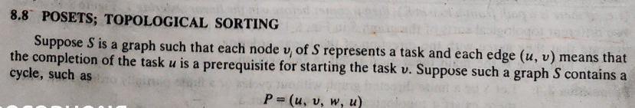
Graphs
This means that we cannot begin v until completing u, we cannot begin w until completing v and we cannot begin u until completing w.
Thus we cannot complete any of the tasks in the cycles. Accordingly such a graph S, representing tasks and a prerequisite relation, cannot have cycles.

Slide 17
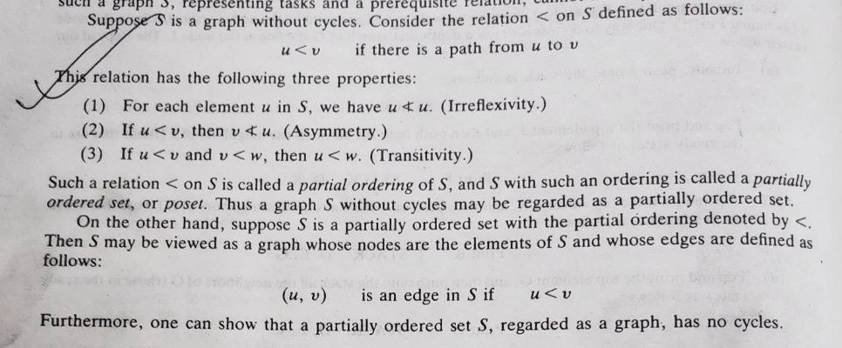
Graphs

Slide 18
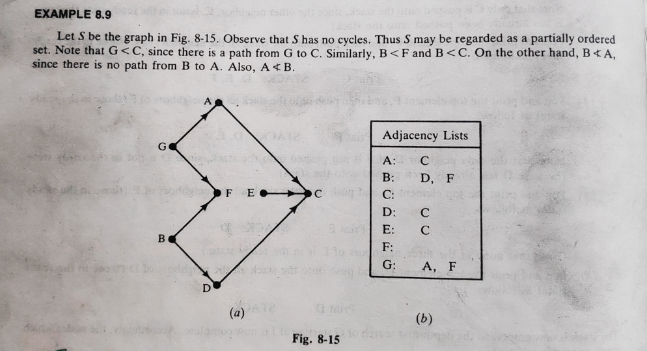
Graphs

Slide 19
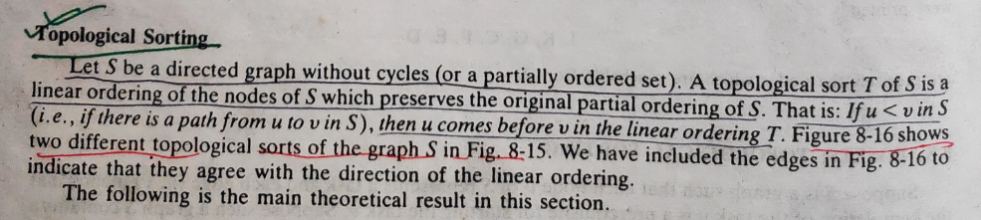
Graphs
Topological Sorting

Slide 20
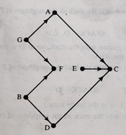
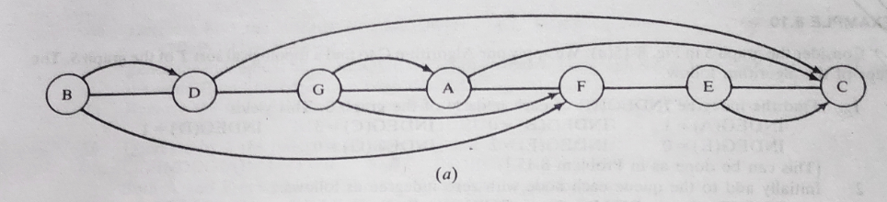
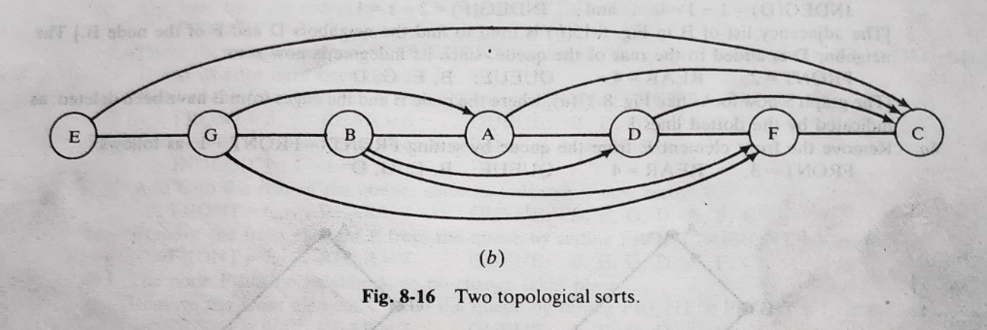
Graphs (Topological Sorting)

Slide 21
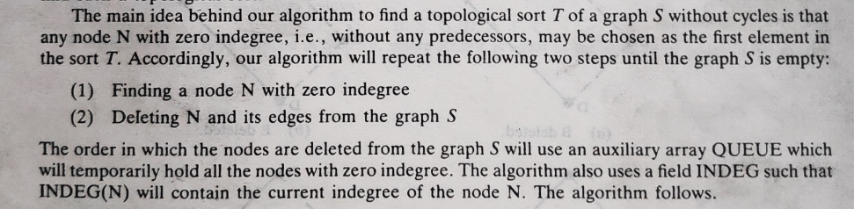
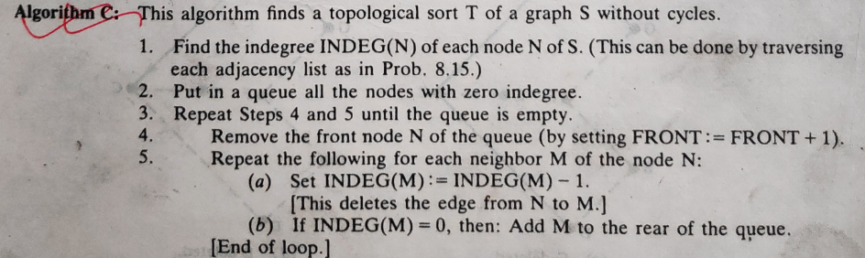

Graphs (Topological Sorting)

Slide 22
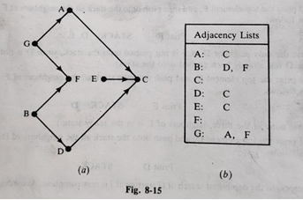
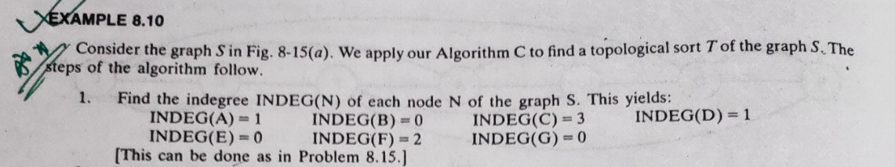
Graphs (Topological Sorting)

Slide 23
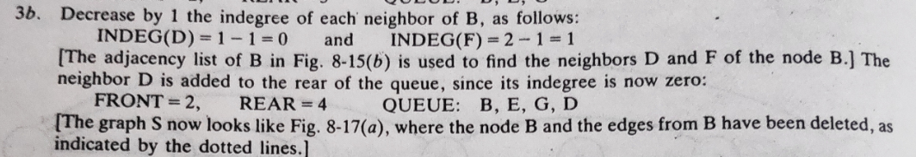
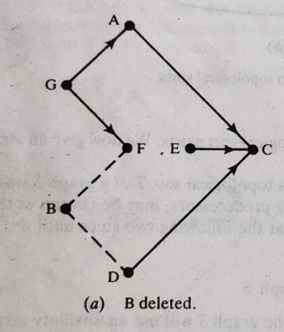
Graphs (Topological Sorting)

Slide 24
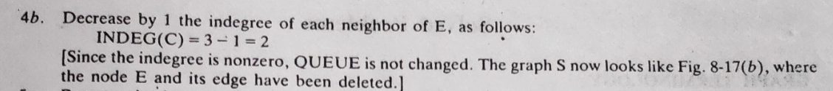
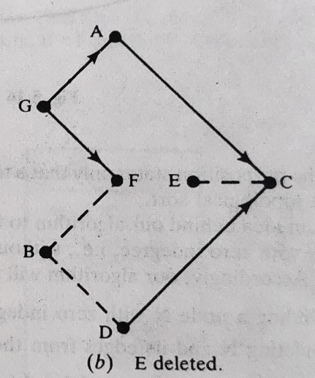
Graphs (Topological Sorting)

Slide 25
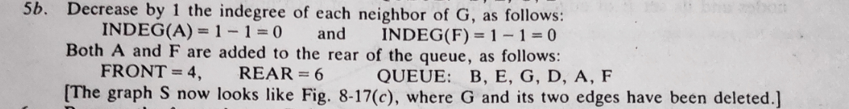
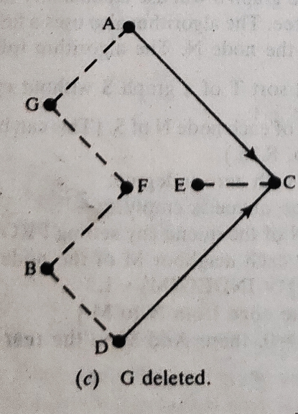
Graphs (Topological Sorting)

Slide 26
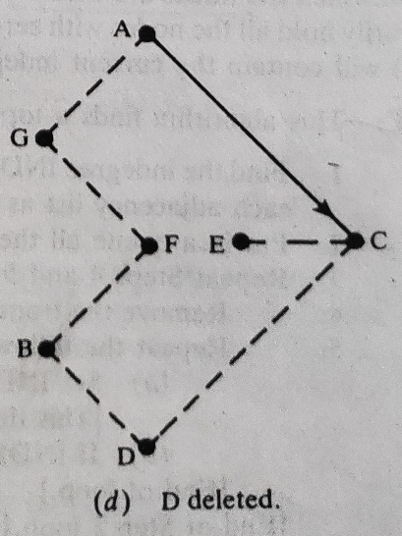
Graphs (Topological Sorting)

Slide 27
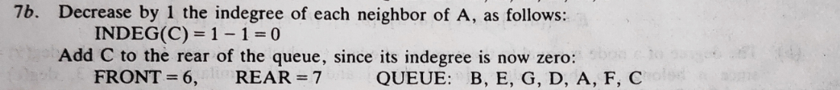
Graphs (Topological Sorting)

Slide 28
Graphs (Topological Sorting)

Slide 29
Graphs (Topological Sorting)

Slide 30
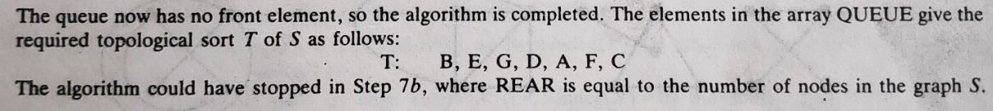
Graphs (Topological Sorting)

Slide 31
Topological Sort
The goal of a Topological Sort:
When given a list of items with dependencies (i.e. item 5 must be completed before item 3, etc.)
Produce an ordering of the items that satisfies the given constraints.
In order for the problem to be solvable, there can’t be a cyclic set of constraints.
We can’t have item 5 must be completed before item 3, item 3 must be completed before item 7, and item 7 must be completed before item 5.
Since that would be IMPOSSIBLE!!

Slide 32
Topological Sort
A stands for waking up,
B stands for taking a shower,
C stands for eating breakfast
D leaving for work
The constraints would be
A before B,
A before C,
B before D,
and C before D.
We can model dependencies (or constraints) like these using
A Directed Acyclic Graph
Given a set of items and constraints, we create the corresponding graph as follows:
Each item corresponds to a vertex in the graph.
For each constraint where item A must finish before item B, place a directed edge A → B.
A
B
C
D
A topological sort would give A, B, C, D.

Slide 33
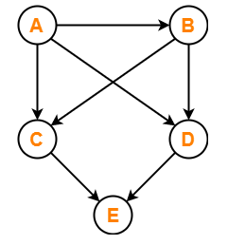
Topological sort: Example-01
Find the number of different topological orderings possible for the given graph-

Slide 34
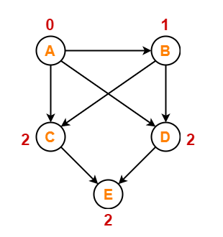
Solution: Example-01
Step:1 Write in-degree of each vertex-

Slide 35
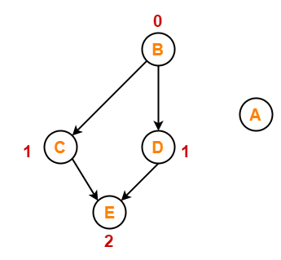
Solution: Example-01
Step:2
Vertex-A has the least in-degree.
So, remove vertex-A and its associated edges.
Now, update the in-degree of other vertices.

Slide 36
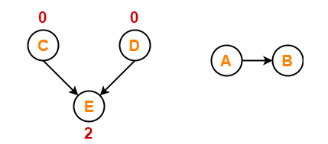
Solution: Example-01
Step:3
Vertex-B has the least in-degree.
So, remove vertex-B and its associated edges.
Now, update the in-degree of other vertices.

Slide 37
Solution: Example-01
Step:4
There are two vertices with the least in-degree. So, following 2 cases are possible-
In Case 1:
Remove vertex-C and its associated edges.
Then, update the in-degree of other vertices.
In Case 2:
Remove vertex-D and its associated edges.
Then, update the in-degree of other vertices.

Slide 38
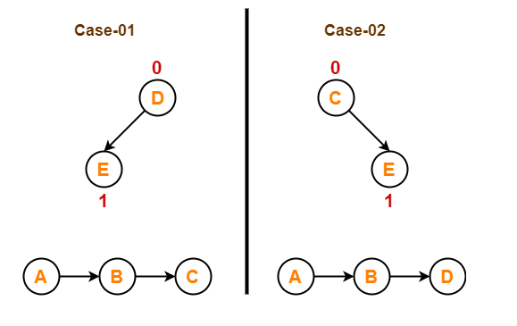
Solution: Example-01
Step:4

Slide 39
Solution: Example-01
Step:5
Now, the above two cases are continued separately in the similar manner.
In Case 1:
Remove vertex-D since it has the least in-degree.
Then, remove the remaining vertex-E.
In Case 2:
Remove vertex-C since it has the least in-degree.
Then, remove the remaining vertex-E.

Slide 40
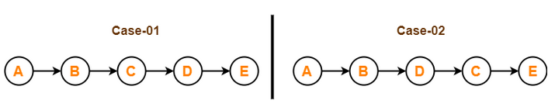
Solution: Example-01
Step:5
Conclusion:
For the given graph, following 2 different topological orderings are possible-
A B C D E
A B D C E

Slide 41
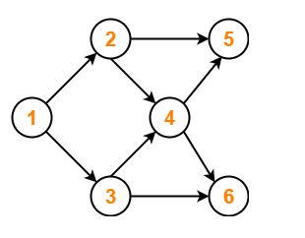
Topological sort: Example-02
Find the number of different topological orderings possible for the given graph-

Slide 42
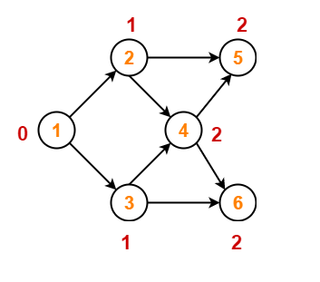
Solution: Example-02
Step:1
Write in-degree of each vertex.

Slide 43
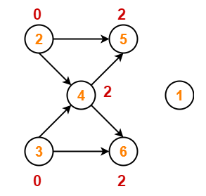
Solution: Example-02
Step:2
Vertex-1 has the least in-degree.
So, remove vertex-1 and its associated edges.
Now, update the in-degree of other vertices.

Slide 44
Solution: Example-02
Step:3
There are two vertices with the least in-degree. So, following 2 cases are possible-
In case-01,
Remove vertex-2 and its associated edges.
Then, update the in-degree of other vertices.
In case-02,
Remove vertex-3 and its associated edges.
Then, update the in-degree of other vertices.

Slide 45

Solution: Example-02
Step:3

Slide 46
Solution: Example-02
Step:4
Now, the above two cases are continued separately in the similar manner.
In case-01,
Remove vertex-3 since it has the least in-degree.
Then, update the in-degree of other vertices.
In case-02,
Remove vertex-2 since it has the least in-degree.
Then, update the in-degree of other vertices.

Slide 47

Solution: Example-02
Step:4

Slide 48
Solution: Example-02
Step:5
In case-01,
Remove vertex-4 since it has the least in-degree.
Then, update the in-degree of other vertices.
In case-02,
Remove vertex-4 since it has the least in-degree.
Then, update the in-degree of other vertices.

Slide 49

Solution: Example-02
Step:5

Slide 50
Solution: Example-02
Step:6
In case-01,
There are 2 vertices with the least in-degree.
So, 2 cases are possible.
Any of the two vertices may be taken first.
Same is with case-02.

Slide 51

Solution: Example-02
Step:6
Conclusion:
For the given graph, following 4 different topological orderings are possible-
1 2 3 4 5 6
1 2 3 4 6 5
1 3 2 4 5 6
1 3 2 4 6 5

Slide 52
Solution: Example-02
Step:6
In case-01,
There are 2 vertices with the least in-degree.
So, 2 cases are possible.
Any of the two vertices may be taken first.
Same is with case-02.

Slide 53


Graphs (Problems)

Slide 54


Graphs (Problems)

Slide 55


Graphs (Problems)

Slide 56


Graphs (Problems)

Slide 57



Graphs (Problems)

Slide 58

Graphs (Problems)

Slide 59

Graphs (Problems)

Slide 60



Graphs (Problems)

Slide 61


Graphs (Problems)

Slide 62

Graphs (Problems)

Slide 63



Graphs (Problems)

Slide 64


Graphs (Problems)

Slide 65

Graphs (Problems)

Slide 66



Graphs (Problems)

Slide 67
Thank you……

